Slide 1

LINEAR REGRESSION: ASSUMPTIONS

Slide 2


Introduction to linear regression
Do you remember the two types of variables / features? ( Numerical and Categorical? )
Now is when this distinction makes sense as we can have two types of problems in supervised learning:
Regression: (prediction of a numerical feature)
Classification (prediction of a categorical feature)
Supervised learning

Slide 3
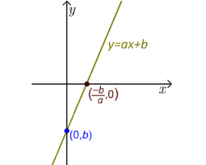
Introduction to machine learning
A linear regression model is a supervised parametric model ( it’s based on a given formula ) which has two parameters:
Slope (a)
Intercept (b)
A linear model can have multiple independent features.
Linear regression model

Slide 4
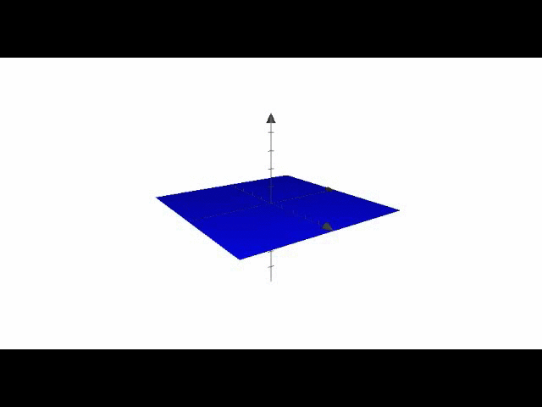
Introduction to machine learning
A linear model can have multiple independent features.
Multiple Linear regression model

Slide 5
Introduction to machine learning
A linear regression model is one particular type of regression which is making the following four assumptions about the data:
Lineality ( the relation between the independent feature and the dependent feature is linear ). Measured by correlation coefficient.
Independency: every observation used to train the model doesn’t depend of another.
Normality: all the variables (independent and dependent) follow a normal distribution
Linear regression assumptions

Slide 6
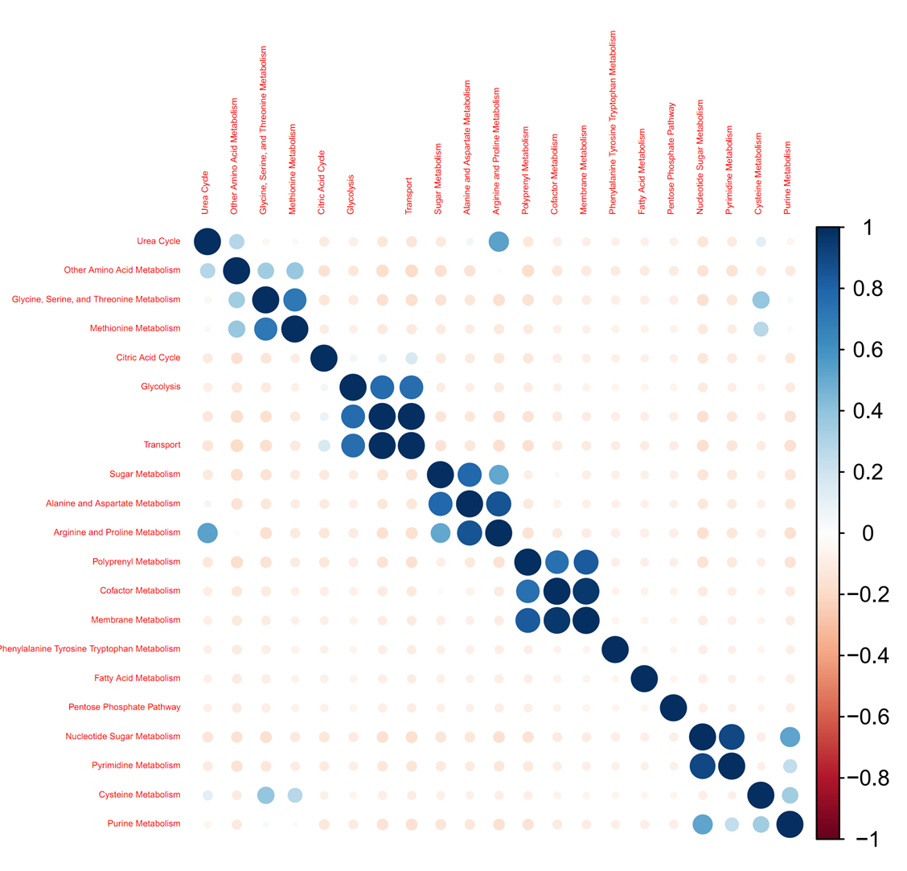
Introduction to machine learning
To check the linearity of the relationship between the dependent feature and the independent feature, check: correlation matrix.
The higher ( in absolute value ) the value of the correlation, the better. A minimum to consider a good correlation value is 0.75, but there is no consensus.
Checking for linearity: correlation matrix

Slide 7
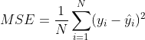
OLS
In order to determine the optimal values for the linear model, this method makes MSE becomes minimum:
Ordinary least square method (OLS)

Slide 8
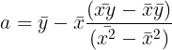
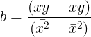
OLS
According to this method the values for the linear model are:
Ordinary least square method (OLS)

